Slide 1

Getting started with NodeBots!
Mark West

Slide 2
Background

Slide 3
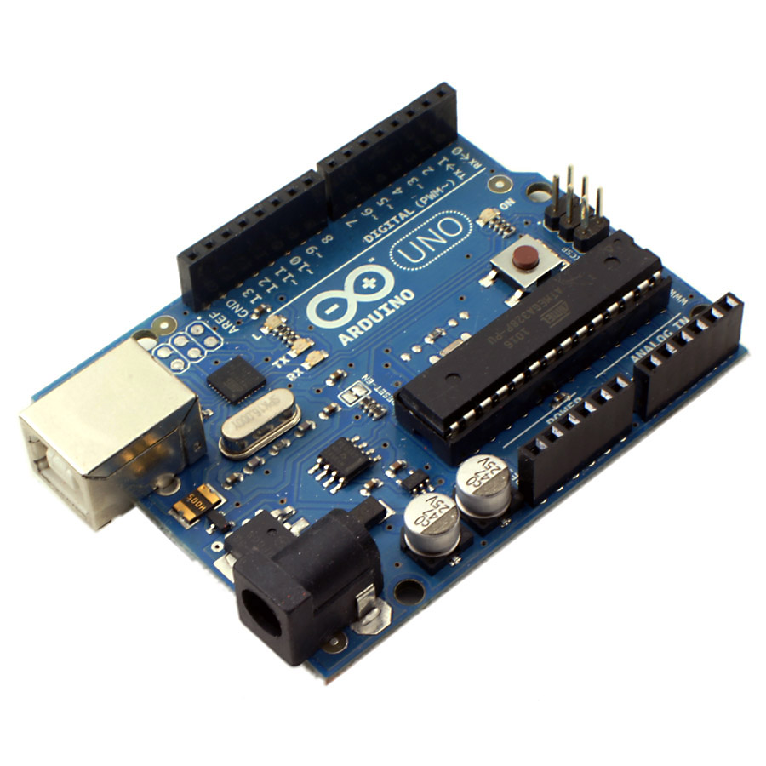




Slide 4
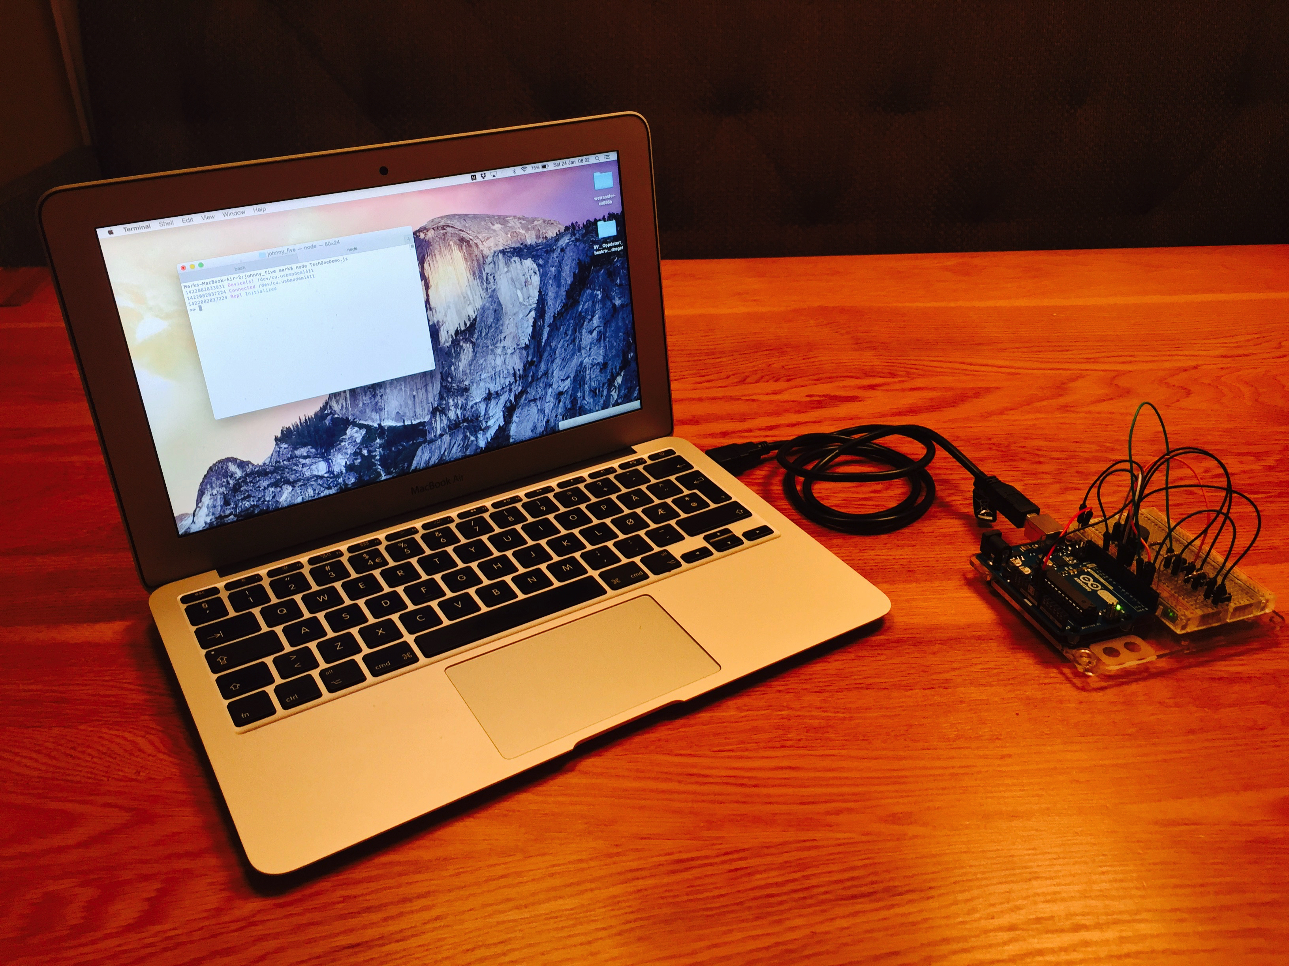
Laptop running Johnny-Five
Serial Cable
Allowing Johnny-Five to talk to Firmata
Arduino Uno running Firmata
Notes:
Note that JavaScript doesn’t run directly on the UNO. So how does Johnny-Five actually work?
Well bascially we start by installing the Firmata Protocol on the Arduino UNO. This provides an API for controlling the board. The Johnny-Five process runs on your laptop and sends commands to the Arduino via the Firmata Protocol. This requires a serial connection, which can be a cable, bluetooth or wireless.

Slide 5
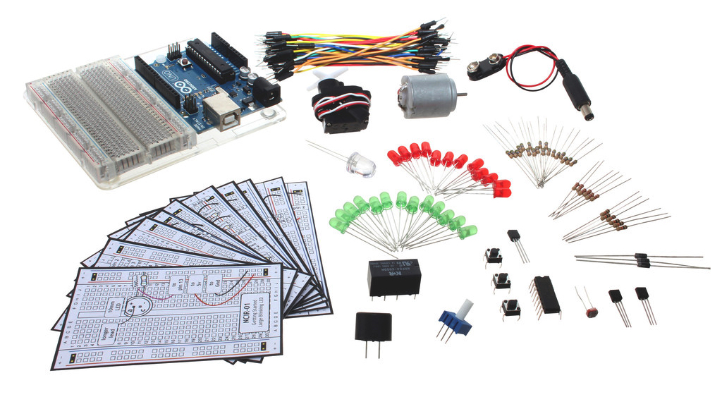
Notes:
So my next step was to buy some equipment – I picked up an Arduino experimenters kit for about 700kr – and now I will show you my first program.

Slide 6
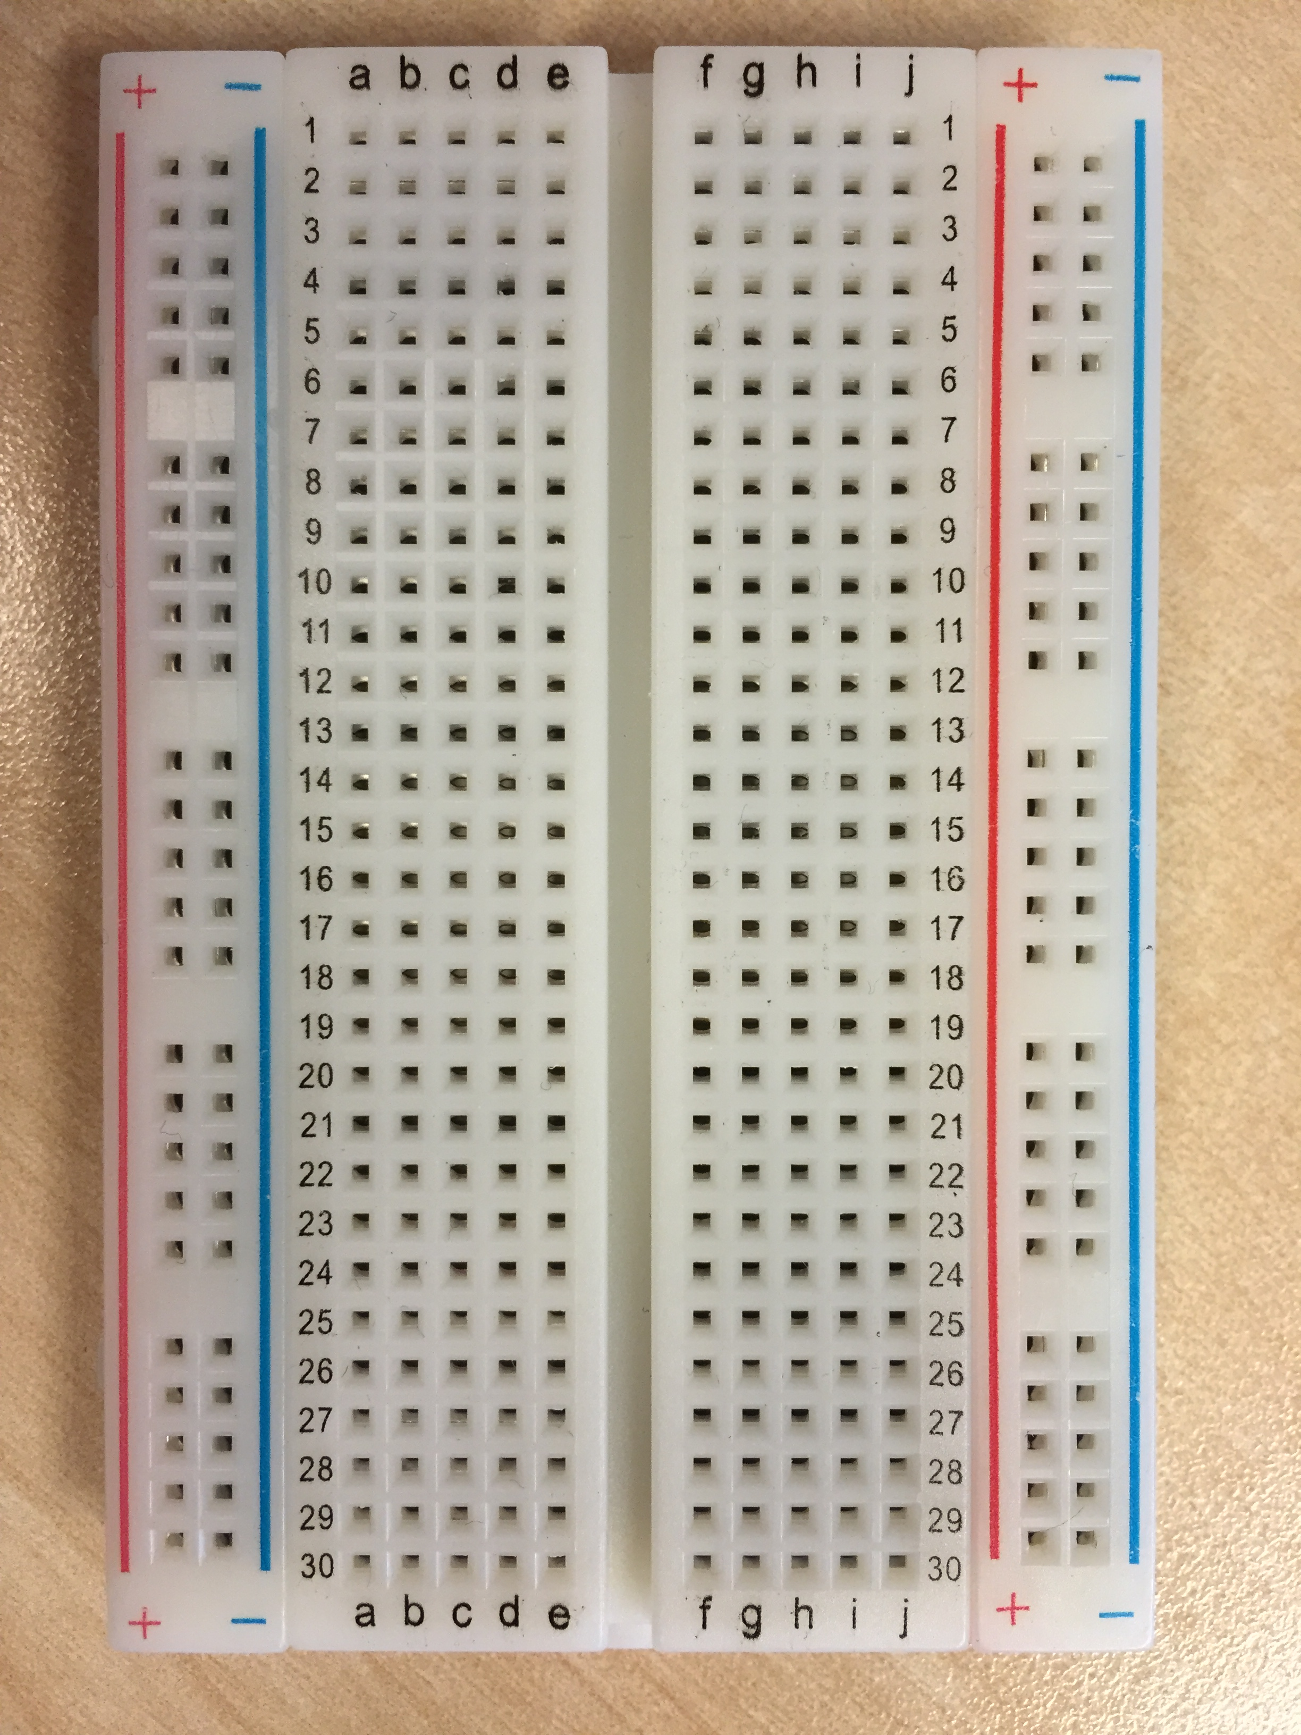
X
X
X
X
X
X
X

Slide 7
Exercises

Slide 8
https://github.com/markwest1972/johnny_five_intro

